Slide 1
Spring boot
Introduction

Slide 2
What is Spring Boot?
Spring Boot makes it easy to create stand-alone, production-grade Spring based Applications that you can "just run".
Most Spring Boot applications need very little Spring configuration.

Slide 3
Features
Create stand-alone Spring applications
Embed Tomcat, Jetty or Undertow directly (no need to deploy WAR files)
Automatically configure Spring whenever possible
Provide production-ready features such as metrics, health checks and externalized configuration
Absolutely no code generation and no requirement for XML configuration
Starter dependencies
Production-ready environment

Slide 4
Spring boot - Starters
Dependency management is a critical aspects of any complex project. And doing this manually is less than ideal; the more time you spent on it the less time you have on the other important aspects of the project.
Spring Boot starters were built to address exactly this problem.
You get a one-stop-shop for all the Spring and related technology that you need, without having to hunt through sample code and copy paste loads of dependency descriptors.
There are more than 30 Boot starters available

Slide 5
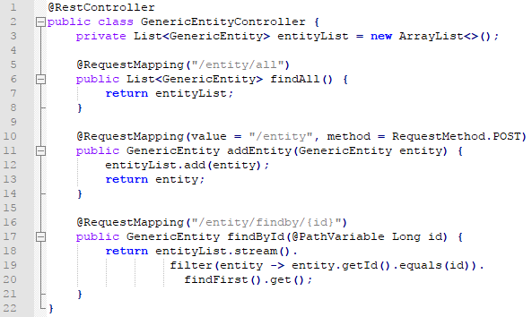
Example Starters
Web Starter
First, let’s look at developing the REST service; we can use libraries like Spring MVC, Tomcat and Jackson – a lot of dependencies for a single application
Spring Boot starters can help to reduce the number of manually added dependencies just by adding one dependency. So instead of manually specifying the dependencies just add one starter as in the following example:
dependencies {
compile('org.springframework.boot:spring-boot-starter-web’)
}
Now we can create a REST controller. For the sake of simplicity we won’t use the database and focus on the REST controller:
The GenericEntity is a simple bean with id of type Long and value of type String.
That’s it – with the application running, you can access http://localhost:8080/springbootapp/entity/all and check the controller is working.
We have created a REST application with quite minimal configuration.

Slide 6
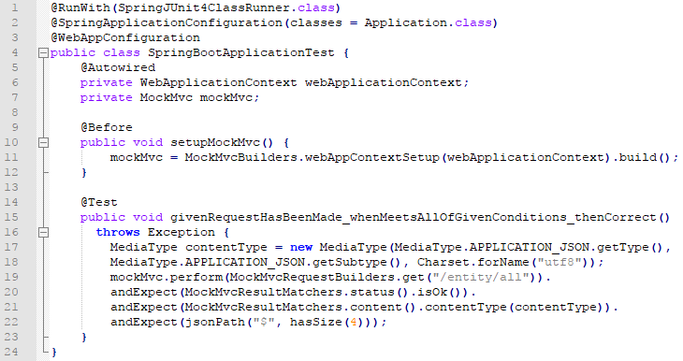
Example Starters
Test Starter
For testing we usually use the following set of libraries: Spring Test, JUnit, Hamcrest and Mockito. We can include all of these libraries manually, but Spring Boot starter can be used to automatically include these libraries in the following way
Spring Boot starters can help to reduce the number of manually added dependencies just by adding one dependency. So instead of manually specifying the dependencies just add one starter as in the following example:
dependencies {
testCompile('org.springframework.boot:spring-boot-starter-test’)
}
Let’s actually test the controller we created in the previous example.
There are two ways to test the controller:
Using the mock environment
Using the embedded Servlet container (like Tomcat or Jetty)
In this example we’ll use a mock environment:
What is important here is that @WebAppConfiguration annotation and MockMVC are part of the spring-test module, hasSize is a Hamcrest matcher, and @Before is a JUnit annotation. These are all available by importing one this one starter dependency.

Slide 7
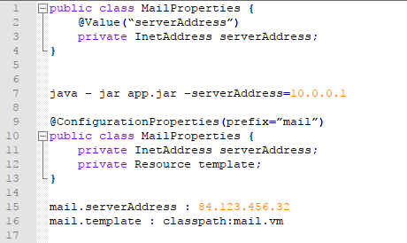
Properties

Slide 8
Profiles
default file is application.properties
customize by spring.config.name
spring.profiles.active = production,mysql
configuration per profile:
application-production.properties
conference-test.properties

Slide 9
Production ready
Monitoring endpoints
/health
/info
/metrics
/trace
JMX / SSH
Auditing

Slide 10
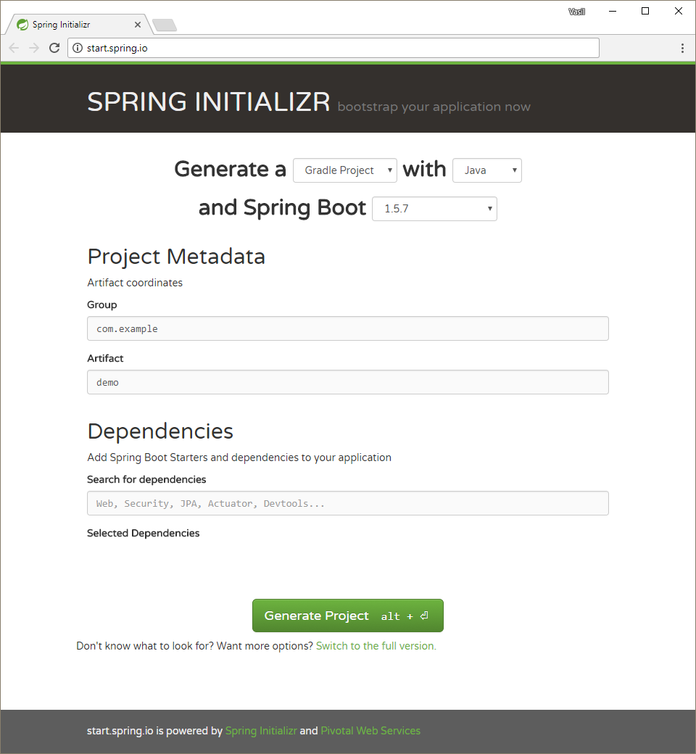
Spring Boot – Project generation
Spring offers convenient
spring project initializer at:
SPRING INITIALIZR (http://start.spring.io/)
Choose your:
Project builder
Language
Version
Artifact group and name
Search for all dependencies you need
Hit “Generate Project” and start codding
There is a more detailed page if you want to select your dependencies from a list
1
2
3
4
5
6
7

Slide 11
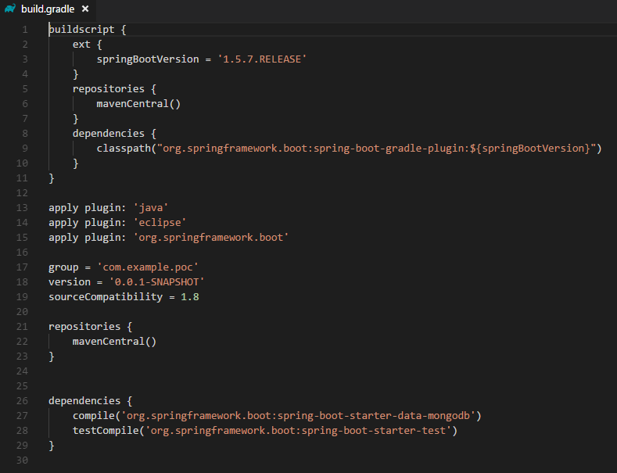
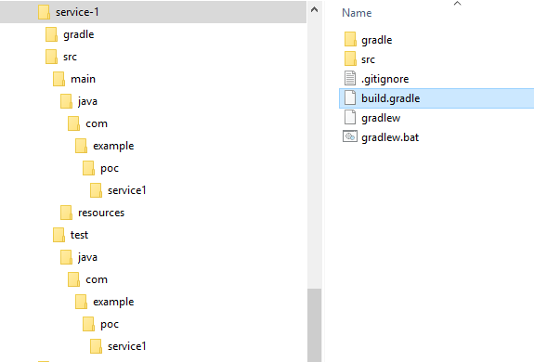
Generated spring boot project
How generated Spring boot project structure
looks like. (mogodb was selected as dependency)

Slide 12
Reading material
Spring Boot Reference Guide
Getting started
‘How-to’ guides

